Slide 1

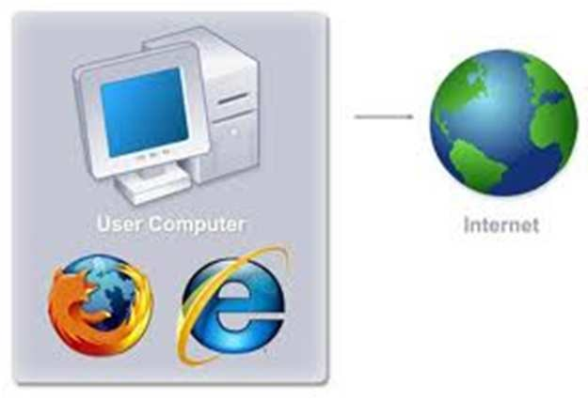
COM 210
Structured Programming
Kariuki Paul
memekariuki@gmail.com

Slide 2
Variables in C
Topics
Naming Variables
Declaring Variables
Using Variables
The Assignment Statement

Slide 3
Naming Variables
A variable is a named location in computer memory.
Variables in C may be given representations containing multiple characters. But there are rules for these representations.
Variable names in C
  May only consist of letters, digits, and underscores
  May be as long as you like, but only the first 31 characters are significant
  May not begin with a number
  May not be a C reserved word (keyword)

Slide 4
Reserved Words (Keywords) in C
Keywords: These are reserved words of the C language
auto break
case char
const continue
default do
double else
enum extern
float for
goto if
int long
register return
short signed
sizeof static
struct switch
typedef union
unsigned void
volatile while

Slide 5
Naming Conventions
C programmers generally agree on the following conventions for naming variables.
  Begin variable names with lowercase letters
  Use meaningful identifiers
  Separate “words” within identifiers with underscores or mixed upper and lower case.
  Examples: surfaceArea surface_Area surface_area
  Be consistent!

Slide 6
Naming Conventions (con’t)
Use all uppercase for symbolic constants (used in #define preprocessor directives).
Examples:
#define PI 3.14159
#define AGE 52

Slide 7
Case Sensitivity
C is case sensitive
  It matters whether an identifier, such as a variable name, is uppercase or lowercase.
  Example:
  area
  Area
  AREA
  ArEa
  are all seen as different variables by the compiler.

Slide 8
Declaring Variables
Before using a variable, you must give the compiler some information about the variable; i.e., you must declare it.
The declaration statement includes the data type of the variable.
Examples of variable declarations:
int meatballs ;
float area ;

Slide 9
Declaring Variables (con’t)
When we declare a variable
  Space is set aside in memory to hold a value of the specified data type
  That space is associated with the variable name
  That space is associated with a unique address

Slide 10
Using Variables: Initialization
Variables may be be given initial values, or initialized, when declared. Examples:
int length = 7 ;
float diameter = 5.9 ;
char initial = ‘A’ ;
length
7
diameter
5.9
initial
‘A’

Slide 11
Using Variables: Initialization (con’t)
Do not “hide” the initialization
  put initialized variables on a separate line
  a comment is always a good idea
  Example:
  int height ; /* rectangle height */
  int width = 6 ; /* rectangle width */
  int area ; /* rectangle area */
  NOT int height, width = 6, area ;

Slide 12
Using Variables: Assignment
Variables may have values assigned to them through the use of an assignment statement.
Such a statement uses the assignment operator =
This operator does not denote equality. It assigns the value of the righthand side of the statement (the expression) to the variable on the lefthand side.
Examples:
diameter = 5.9 ;
area = length * width ;
Note that only single variables may appear on the lefthand side of the assignment operator.

Slide 13
Example: Declarations and Assignments
#include <stdio.h>
int main( )
{
int inches, feet, fathoms ;
fathoms = 7 ;
feet = 6 * fathoms ;
inches = 12 * feet ;
inches
garbage
feet
garbage
fathoms
garbage
fathoms
7
feet
42
inches
504

Slide 14
Example: Declarations and Assignments (cont’d)
printf (“Its depth at sea: \n”) ;
printf (“ %d fathoms \n”, fathoms) ;
printf (“ %d feet \n”, feet) ;
printf (“ %d inches \n”, inches) ;
return 0 ;
}

Slide 15
Enhancing Our Example
What if the depth were really 5.75 fathoms? Our program, as it is, couldn’t handle it.
Unlike integers, floating point numbers can contain decimal portions. So, let’s use floating point, rather than integer.
Let’s also ask the user to enter the number of fathoms, rather than “hard-coding” it in.

Slide 16
Enhanced Program
#include <stdio.h>
int main ( )
{
float inches, feet, fathoms ;
printf (“Enter the depth in fathoms : ”) ;
scanf (“%f”, &fathoms) ;
feet = 6 * fathoms ;
inches = 12 * feet ;
printf (“Its depth at sea: \n”) ;
printf (“ %f fathoms \n”, fathoms) ;
printf (“ %f feet \n”, feet) ;
printf (“ %f inches \n”, inches) ;
return 0 ;
}

Slide 17
Final “Clean” Program
#include <stdio.h>
int main( )
{
float inches ; /* number of inches deep */
float feet ; /* number of feet deep */
float fathoms ; /* number of fathoms deep */
/* Get the depth in fathoms from the user */
printf (“Enter the depth in fathoms : ”) ;
scanf (“%f”, &fathoms) ;
/* Convert the depth to inches */
feet = 6 * fathoms ;
inches = 12 * feet ;

Slide 18
Final “Clean” Program (con’t)
/* Display the results */
printf (“Its depth at sea: \n”) ;
printf (“ %f fathoms \n”, fathoms) ;
printf (“ %f feet \n”, feet);
printf (“ %f inches \n”, inches);
return 0 ;
}

Slide 19
Good Programming Practices
Place each variable declaration on its own line with a descriptive comment.
Place a comment before each logical “chunk” of code describing what it does.
Do not place a comment on the same line as code (with the exception of variable declarations).
Use spaces around all arithmetic and assignment operators.
Use blank lines to enhance readability.

Slide 20
Good Programming Practices (con’t)
Place a blank line between the last variable declaration and the first executable statement of the program.
Indent the body of the program 3 to 4 tab stops -- be consistent!

Slide 21
Global and Local Variables
Global Variables
  These variables are declared outside all functions.
  Life time/scope of a global variable is the entire execution period of the program.
  Can be accessed by any function defined below the declaration, in a file.
/* Compute Area and Perimeter of a circle */
#include <stdio.h>
float pi = 3.14159; /* Global */
main() {
float rad; /* Local */
printf( “Enter the radius “ );
scanf(“%f” , &rad);
if ( rad > 0.0 ) {
float area = pi * rad * rad;
float peri = 2 * pi * rad;
printf( “Area = %f\n” , area );
printf( “Peri = %f\n” , peri );
}
else
printf( “Negative radius\n”);
printf( “Area = %f\n” , area );
}

Slide 22
Global and Local Variables
Local Variables
  These variables are declared inside some functions.
  Life time/scope of a local variable is the entire execution period of the function in which it is defined.
  Cannot be accessed by any other function.
  In general variables declared inside a block are accessible only in that block.
/* Compute Area and Perimeter of a circle */
#include <stdio.h>
float pi = 3.14159; /* Global */
main() {
float rad; /* Local */
printf( “Enter the radius “ );
scanf(“%f” , &rad);
if ( rad > 0.0 ) {
float area = pi * rad * rad;
float peri = 2 * pi * rad;
printf( “Area = %f\n” , area );
printf( “Peri = %f\n” , peri );
}
else
printf( “Negative radius\n”);
printf( “Area = %f\n” , area );
}

Slide 23
ENVIRONMENT VARIABLES IN C:
NB: (TO BE TESTED ON LINUX PLATFORM)
Environment variable is a variable that will be available for all C applications and C programs.
We can access these variables from anywhere in a C program without declaring and initializing in an application or C program.
The inbuilt functions which are used to access, modify and set these environment variables are called environment functions.
There are 3 functions which are used to access, modify and assign an environment variable in C. They are,
1. setenv()
2. getenv()
3. putenv()

Slide 24

EXAMPLE PROGRAM FOR GETENV() FUNCTION IN C:
This function gets the current value of the environment variable. Let us assume that environment variable DIR is assigned to “/usr/bin/test/”.
    #include <stdio.h>
    #include <stdlib.h>
    int main()
    {
    printf("Directory = %s\n",getenv("DIR"));
    return 0;
    }

Slide 25

EXAMPLE PROGRAM FOR SETENV() FUNCTION IN C:
This function sets the value for environment variable. Let us assume that environment variable “FILE” is to be assigned “/usr/bin/example.c”
#include <stdio.h>
#include <stdlib.h>
int main()
{
setenv("FILE", "/usr/bin/example.c",50);
printf("File = %s\n", getenv("FILE"));
return 0;
}

Slide 26
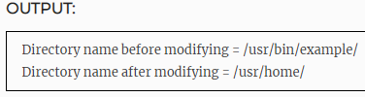
EXAMPLE PROGRAM FOR PUTENV() FUNCTION IN C:
This function modifies the value for environment variable. Below example program shows that how to modify an existing environment variable value.
#include <stdio.h> #include <stdlib.h> int main() { setenv("DIR", "/usr/bin/example/",50); printf("Directory name before modifying = " \ "%s\n", getenv("DIR")); putenv("DIR=/usr/home/"); printf("Directory name after modifying = " \ "%s\n", getenv("DIR")); return 0; }

